Slide 1
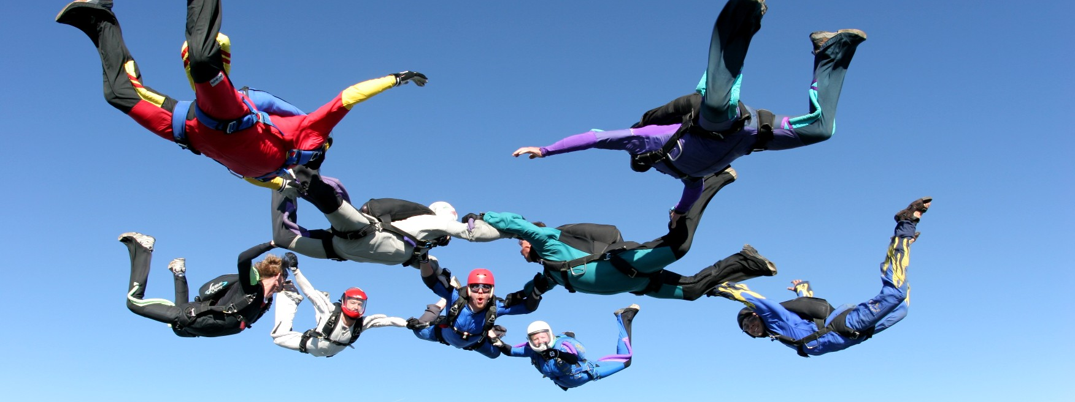

Team Management
February 2014
This document is confidential and contains proprietary information, including trade secrets of CitiusTech. Neither the document nor any of the information contained in it may be reproduced or disclosed to any unauthorized person under any circumstances without the express written permission of CitiusTech.

Slide 2
Agenda
Team Stages
Key Components Of Team Management
Team Induction
Co-ordination And Communication
Delegation
Motivation and Grooming
Conflicts Management
Evaluation & Retrospection
Making It Work @ CitiusTech
Q&A

Slide 3
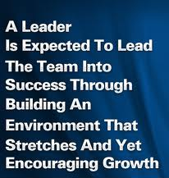
Team Management – Leader’s Role
Team Management is a key aspect of successful leadership
True leadership is about creating an environment for the team to perform and deliver to their optimal potential
True leadership is about providing a growth opportunity for team members so as to create future leaders
Effective team management is in a way about becoming an effective leader by earning love and respect of team members

Slide 4
Team Management : Team Stages (1/2)
Key
Phases
Forming
Storming
Norming
Performing
Adjourning
There are typically five stages of development that team may go through.
In a project lifecycle these stages occur is order i.e. Forming, Storming, Norming, Performing and Adjourning.
The team may get stuck in a particular stage or skip to a later stage.
The duration of a particular stage depends on the team size and team leadership.
Project leads should have good understanding of team dynamics in order to move the team members through all the stages in effective manner.

Slide 5
Team Management : Team Stages (2/2)
Key
Phases
Forming
Storming
Norming
Performing
Adjourning
Team members are independent and not as open
Team meets and learns about the project
Understands roles and responsibilities
Team begins to address project work, technical decisions and project management approach
Environment can become destructive if team members are not open to differing ideas and perspective
Team begins to work together
Adjusts work habits and behavior
The team begins to trust each other
Team is now a well functioning unit
They are inter dependent and work through issues smoothly and effectively
Team productivity is at its best
The team completes the work and moves on from the project

Slide 6
Agenda
Team Stages
Key Components Of Team Management
Team Induction
Co-ordination And Communication
Delegation
Building Trust
Motivation and Grooming
Conflicts Management
Evaluation & Retrospection
Making It Work @ CitiusTech
Q&A

Slide 7
Team Management – Tools & Techniques
Team Management
Induction
Co-ordination
& Communication
Conflicts Management
Delegation
Grooming
&
Motivation
Evaluation & Retrospection
Effective Team Management is essential for successful project execution , improving the team productivity
Healthy Team culture contributes in maintaining a healthy organizational culture
One need to use combination of tools and techniques for effective team management throughout the team stages
CT tools and processes help to effectively manage teams and team members

Slide 8
Agenda
Team Stages
Key Components Of Team Management
Team Induction
Co-ordination And Communication
Delegation
Building Trust
Motivation and Grooming
Conflicts Management
Evaluation & Retrospection
Making It Work @ CitiusTech
Q&A

Slide 9
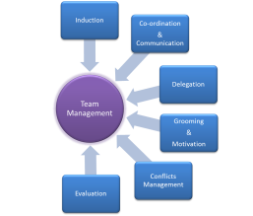
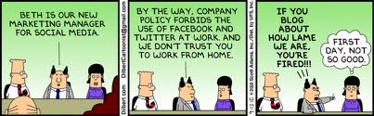
Team Management: Team Induction ☺ (1/3)

Slide 10
Team Management: Team Induction (2/3)
Making person comfortable with the team - Feel at Home
Making him/her aware of the project objectives, milestones – A Bigger Picture
Makes him/her aware of their role and responsibility in a project –Expectation setting
Strengthening their commitment to the project by early involvement and participation in team/project activities
Providing clarity on internal and external stakeholders and their influences on the project
Getting to know different mediums of communication and touch points with client and internal management team.

Slide 11
Team Management: Team Induction @CT (3/3)
Tools | Objectives
Buddy (For New Joinees) | Make the person feel “at home”
Team Mentor | Guide the new joinee during the project induction phase Making him/her familiar with the client and CitiusTech workflows
Project Induction Checklist Project Overview Training Plans (Technical/Functional/Organizational) Sharing of Stakeholder Register Escalation Metrics Communication Plan | Enables structured induction in project Project objectives known upfront Aware of important milestones Setting of expectation done upfront Familiar with stakeholders and their influences on the project Aware of the different medium of communication agreed upon for the project and its frequency
Face to face meeting | Makes a person more comfortable and helps set up bonding
InterCT | Overview of Project site on inteCT

Slide 12
Agenda
Team Stages
Key Components Of Team Management
Team Induction
Co-ordination And Communication
Delegation
Building Trust
Motivation and Grooming
Conflicts Management
Evaluation & Retrospection
Making It Work @ CitiusTech
Q&A

Slide 13
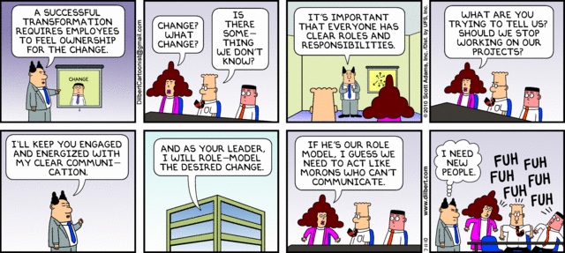
Team Management: Co-ordination & Communication (1/4)

Slide 14
Team Management: Co-ordination & Communication (2/4)
Communication
Project lead spends majority of the time communicating with team members.
Effective team communication is passing information in ‘right format’, at the ‘right time’ , with the ‘right impact’ and directed to ‘right audiences’.
Effective team communication is a key to create synergy within project team members with diverse ethnicities , cultures, levels of expertise, interests and locations
Communication can be -
Project related - Internal (project) and External (customers , partners , vendors)
Formal (reports, memos and briefings) and Informal (emails, ad-hoc discussions)
Vertical (Up and down the organization ) and Horizontal (with peers)
Written and Oral
Verbal and Non-Verbal (body language, voice modulation)
Selection of right communication medium is the key for optimum impact

Slide 15
Team Management: Co-ordination & Communication (3/4)
Coordination
When the team sizes are big and distantly located , coordination becomes a real challenge for the lead
Use of right tools and processes supported by systematic approach helps achieve effective co-ordination

Slide 16
Team Management: Co-ordination & Communication @ CT
Tools | Objectives
CT email groups | Effective and easy team communication
Project Kick off | Awareness of important milestones Project objectives known upfront
Effective use of InterCT/QMS/PGS | Familiarity of organizational/project processes Access to information related to training and quality processes.
Team A & P | An opportunity for team members to share the accomplishments, plans and discuss issues Opportunity to understand about other activities/ learnings from team members Keeping in touch with the team members who may not be co–located (onsite teams) Opportunity to share updates (CT as well as Client side) with the team
One – on – One meetings | Sharing of constructive feedback Discovery of unknown and unresolved issues Development of individual grooming plan

Slide 17
Agenda
Team Stages
Key Components Of Team Management
Team Induction
Co-ordination And Communication
Delegation
Building Trust
Motivation and Grooming
Conflicts Management
Evaluation & Retrospection
Making It Work @ CitiusTech
Q&A

Slide 18
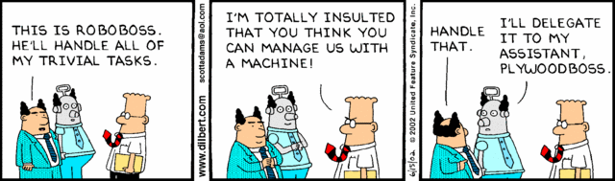
Team Management: Delegation ☺ (1/5)

Slide 19
Team Management: Delegation (2/5)
Leads have many responsibilities. Some of the responsibilities can very well be delegated to competent team members
People don't delegate because it takes a lot of up-front effort
Effective delegation helps building confidence and sense of importance amongst team members
Builds a strong next level of leadership helping lead to grow himself
Delegate when –
You have a capable team members to complete the task
Nature of criticality of the task does not demand you to do it yourself
Task provides an opportunity to grow and develop team member’s skills
Recurring tasks e.g. weekly dashboards, QMS audits etc. which help team member to learn next level of responsibilities
You have a time to review and approve the output
Delegation does not take away the ultimate responsibility and the ownership of the task from you

Slide 20
Team Management: Delegation (3/5)
The Importance of Full Acceptance
Set aside enough time to review the output thoroughly.
Provide constructive feedback (positive and negative) to the team member. Negative feedback should highlight the areas of improvement and positive one should recognize and reward the effort.
As a leader, you should get in the practice of complimenting members of your team every time you are impressed by what they have done.
This effort on your part will go a long way toward building team member's self-confidence and efficiency, both of which will be improved on the next delegated task; it’s a win-win for everyone.

Slide 21
Team Management: Delegation @ CT (4/5)
Tools | Objectives
Sr Management Reviews (project A & P) | Opportunity to represent project in front of Sr. management Interactions with Senior management Learnings from Sr. Management advice/suggestions/ideas Opportunity to get organizational updates
Weekly dashboard and Monthly reviews | Create a second level of leadership to manage client/project in your absence Opportunity for individual to present project status to client and discuss accomplishments and issues Confidence of facing client who otherwise is not accessible to team members Sense of ownership

Slide 22
Team Management: Delegation @ CT (5/5)
Tools | Objectives
TLG initiatives | Delegate tasks from TLG activities depending on the available bandwidth and the motivation level of individual Motivate to create CPD or a training course from project knowledge Sense of importance
QMS – Quality / InfoSec Audits | Make team member(s) lead of audit activities Excitement for playing different but important project roles
Create informal Project roles | Create project roles e.g. QMS lead, Infosec lead, Celebration lead and rotate them frequently Gives an individual experience of performing different tasks Gives a sense of ownership and importance

Slide 23
Agenda
Team Stages
Key Components Of Team Management
Team Induction
Co-ordination And Communication
Delegation
Building Trust
Motivation and Grooming
Conflicts Management
Evaluation & Retrospection
Making It Work @ CitiusTech
Q&A

Slide 24
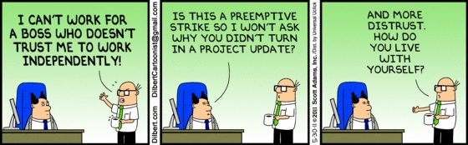
Team Management: Building Trust (1/4)

Slide 25
Team Management: Building Trust (2/4)
One of the most critical components of Team Management
Identified in the “Norming” stage of the team formation.
When people do not trust each other, they cannot operate efficiently
There are two distinct types of trust at work within a project team:
Trust that a person is capable of doing the job they are being asked to do - that they have the skills and knowledge necessary to complete the task.
Trust that a person's intentions are right - that they are not purposely or selfishly acting in a way that is detrimental to the team or the project.
It comes down to "do you trust that I can do the job" and "do you trust that I will do the job".

Slide 26
Team Management: Building Trust (2/4)
There are political, inter-personal, and organizational barriers to establishing trust. A few things that can be done are as follows
Approach | Description
Build Relationships | Most people have a natural distrust for people they don't know on a personal level. Get to know your team - find common interests, shared values, and similar challenges that you may have faced. Learn what motivates each person (upcoming post about this), what fears they have, and what their goals are.
Demonstrate Your Experience | “Management is a skill that translates to any field or industry, and that a good manager can manage any project, regardless of expertise in a particular field.“ There would be a huge loss of efficiency due to the trust factor. The team would have no assurance that the manager will make informed decisions Manager with expertise can jump in and help when there are hurdles to overcome by taking an active role and working alongside your team

Slide 27
Team Management: Building Trust (3/4)
Approach | Description
Be Trustworthy | Don't play games, wage politics, or pit people against each other. Put the interests of the team and the project above your own. Trust is a two-way street, and it always starts with the leadership.
Ask for it | Be open with your team about the importance of trust. Tell them you will be open and honest with them, and you expect the same from them.
Guard it Carefully | Trust is established over time, but destroyed in an instant. Resist the urge to cut corners, play favorites, or steer decisions to your own advantage. If you have a team member who is violating the team's trust, call them out. You may lose favor with that one person but you will maintain the trust of the rest of your team.

Slide 28
Team Management: Building Trust @CT (4/4)
Tools | Objectives
Face to face meeting | Makes a person more comfortable and helps set up bonding
Team A & P | Team members to share the accomplishments, plans and issues Understand about other activities/ learnings from team members Keeping in touch with the team members who may not be co–located (onsite teams)
Create informal Project roles | Create project roles e.g. QMS lead, Infosec lead, Celebration lead etc. Rotate them frequently. Gives an individual experience of performing different tasks Gives a sense of trust
At CitiusTech we inherently tend to trust a person until that person proves us wrong.

Slide 29
Agenda
Team Stages
Key Components Of Team Management
Team Induction
Co-ordination And Communication
Delegation
Building Trust
Motivation and Grooming
Conflicts Management
Evaluation & Retrospection
Making It Work @ CitiusTech
Q&A

Slide 30
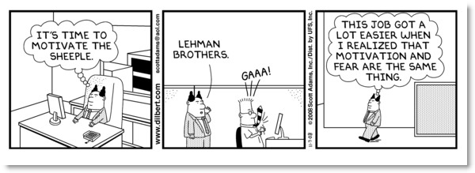
Team Management: Grooming and Motivation ☺ (1/6)

Slide 31
Team Management: Grooming and Motivation (2/6)
Some theories on Motivation
Maslow’s Hierarchy of Needs: People are not most motivated to work by security or money. Instead, the highest motivation is to contribute and use their skills. Maslow called this “self actualization”
Self Actualization
Self fulfillment, growth and learning
Esteem
Accomplishment, respect, attention, appreciation
Social
Love, affection, approval, friends, association
Safety
Security, stability and freedom from harm
Physiological
Need for air, water, food housing, clothing

Slide 32
Team Management: Grooming and Motivation (3/6)
David McClelland’s Theory of Needs: People are most motivated by one of the three needs listed in following table. A person falling into one category would be managed differently than a person falling into another category
Primary Need | Behavioral Style
Need for Achievement | These people should be given projects that are challenging but are achievable. They like recognition.
Need for Affiliation | These people work best when cooperating with others. They seek approval rather than recognition.
Need for Power | People whose need for power is socially oriented, rather than personally oriented are effective leaders and should be allowed to manage others. These people like to organize and influence others.

Slide 33
Team Management: Grooming and Motivation (4/6)
Positive reinforcement through public recognition and reward for good performance and desirable behavior
Identification of star performers and having plan for grooming them
Providing opportunities for learning, self development and growth for team members
Celebrating and recognizing project/team achievements during the life cycle of the project
Careful demarcation of desirable behavior. For e.g. working overtime to meet an aggressive schedule objective vs. needing to work overtime as a result of poor planning by the team.
Avoid rewards that only a limited number of project team members can achieve e.g. Team Member of the Month can hurt team cohesiveness
Having a personalized development/grooming plan for every team member based on his capabilities and preferences

Slide 34
Team Management: Grooming & Motivation @ CT (5/6)
Tools | Objectives
TLG initiatives & CTPs | Based on skills and commitment levels nominate team members for TLG projects Encourage them to participate in CTPs and other organizational initiatives Identify strength areas of team members and encourage them to impart trainings, contribute to CurioCT, help other projects Provide opportunity to contribute at org level and get org wide exposure
Quality / InfoSec Audits | Make team member(s) lead of audit activities Excitement for playing different but important project roles
Trainings and development plan | Enrolling team members to relevant programs to enhance their skills Sharing focus areas and development plan during appraisals and review the same regularly (informal)

Slide 35
Team Management: Grooming & Motivation @ CT (6/6)
Tools | Objectives
Client Feedback and appreciations | Publish client appreciation for team or team member(s) , however small it is Use ‘IAppreciate’ to appreciate extraordinary and out of the way contribution from team members
Weekly Dashboard / Monthly review with Client | Opportunity for client interaction Sense of importance and ownership Improved confidence, communication and presentation skills
Sr. Management reviews | Opportunity for Sr. Management interaction Exposure at organization level Sense of importance and ownership
Team celebrations | Congratulate and celebrate project / personal achievements Team bonding through outings (use quarterly budget wisely and don’t let it lapse ☺)
Extracurricular activities | Encourage team members to participate in company activities to bring out best in them

Slide 36
Agenda
Team Stages
Key Components Of Team Management
Team Induction
Co-ordination And Communication
Delegation
Building Trust
Motivation and Grooming
Conflicts Management
Evaluation & Retrospection
Making It Work @ CitiusTech
Q&A

Slide 37
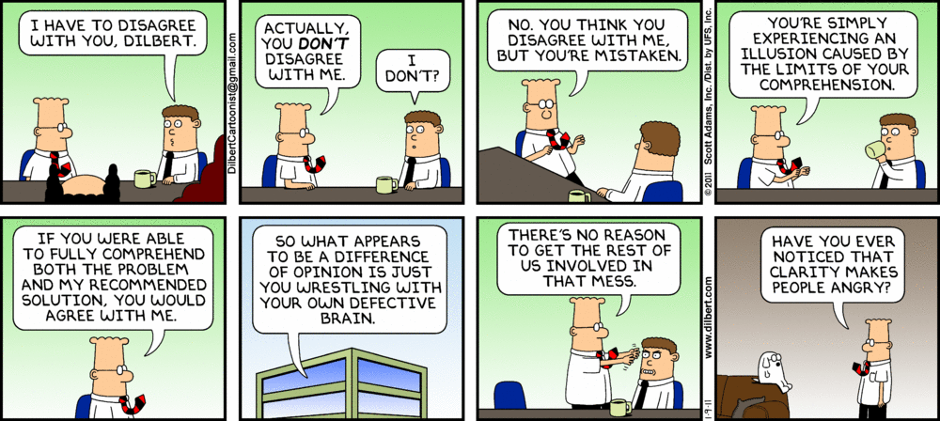
Team Management: Conflicts Management ☺ (1/5)

Slide 38
Team Management: Conflicts Management (2/5)
Conflicts are inevitable in a project environment
Common sources of conflict are : Project Schedules, Project Priorities, Resources , Technical Opinion, Processes, Personality (commitments, comparisons, skills etc. )
Successful conflict management results in greater productivity and helps in building healthy and positive working relationship.
However small the conflict is, it need to be given appropriate time , attention and importance
Real skill is to manage every conflict professionally and to the satisfaction of all the parties involved
Conflicts with individual team member should be addressed in closed doors – Very important
Resolution of conflict is a process and not a one time activity. Needs a review even after it is resolved

Slide 39
Team Management: Conflicts Management (3/5)
There are six general techniques for resolving conflict. Each one has its place and use and are not in any particular order.
Technique | Description
Withdrawing/Avoiding | Retreating from an actual or potential conflict situation.
Smoothing/Accommodating | Emphasizing the areas of agreement rather than areas of difference.
Compromising | Searching for solution that bring some degree of satisfaction to all the parties involved.
Forcing | Pushing ones view point at the expense of others. Generally a win-lose situation.
Collaborating | Incorporating multiple view points and insights from different perspectives; leads to consensus and commitment.
Confronting/Problem Solving | Treating conflict as a problem to be solved by examining alternatives, requires give and take and open dialog.

Slide 40
Team Management: Conflicts Management (4/5)
Examples :
Description | Conflict Resolution
“It seems the real issue here is not a lack of communication, but lack of knowledge of what needs to be done and when. Here is a copy of project schedule. It should help you to understand what you need to know.” | Confronting
“In absence of consensus I think we should do it my way” | Forcing
“Let’s calm down and get the job done.” | Smoothing
“Lets do a little of what both of you suggest” | Compromising
“Let’s deal with the issue next week if it is not pressing” | Withdrawal
“We have talked about insufficient dev environments at client side. We have already discussed the alternatives. I do not want to give same excuse, Let us move ahead” | Forcing
“Let’s see what everyone thinks, and try and reach a consensus. | Collaborating
“Since we cannot decide on the purchase of new computers, we will have to wait until our meeting next month.” | Withdrawal

Slide 41
Team Management: Conflicts Management @ CT (5/5)
Tools | Objectives
One – on – One meetings | Conflicts/Issues with individuals must be addressed in one to one meeting in a closed doors Always hear all the parties involved independently, promise them to address it taking into consideration of all facts Do not hurry up for resolution Decide the course of action which will satisfy all the parties to maximum extent, if not completely Get the buy in from all. Use ‘Veto’ only in case required ☺ Follow up after some time
Team A & P | Allow Team to raise issues/concerns in A&P Address only team issues during A&P
Team Meetings | Generalize the discussions rather than pin pointing to single person (address the same later in closed room with the individual)

Slide 42
Agenda
Team Stages
Key Components Of Team Management
Team Induction
Co-ordination And Communication
Delegation
Building Trust
Motivation and Grooming
Conflicts Management
Evaluation & Retrospection
Making It Work @ CitiusTech
Q&A

Slide 43
Team Management: Evaluation & Retrospection (1/2)
The Retrospect is one of the most effective processes for capturing lessons learned from a project team, after the end of a piece of work.
With a Retrospect, we can bring out the key knowledge and experience developed by a project team, and turn it into actions and resources for the benefit of future projects.
Retrospectives are widely regarded as the most indispensable of people-focused techniques.
Retrospection is a process and can be used at the project as well at individual level
Retrospectives can be wasteful if there are no learnings and action plan coming as an outcome.
Worse than being ineffective or a waste of time, badly run retrospectives can be destructive and harmful to the team; it requires facilitation skills and the ability to lead a group away from negative discussion toward positive outcomes.

Slide 44
Team Management: Evaluation & Retrospection @ CT (2/2)
Tools | Objectives
One – on – One meetings | Provide constructive feedback Discussion of unknown and unresolved issues Identification of individual training needs/plans
Performance Reviews/Project Metrics Sheet | Measure, compare and analyze performance such as actual start, percent complete etc. Use Project metrics as a tool to continuously improve team performance Analyze the progress on self development plan / identified areas of focus
Client Feedback | Receive feedback from client at frequent interval Understanding the concerns (if any) and proactively working to close them with team members
Team Retrospective Meetings | Discussion on what worked well for the team, areas of improvement etc. The objective of the discussion should not be to pin point individual fault

Slide 45
Agenda
Team Stages
Key Components Of Team Management
Team Induction
Co-ordination And Communication
Delegation
Building Trust
Motivation and Grooming
Conflicts Management
Evaluation & Retrospection
Making It Work @ CitiusTech
Q&A

Slide 46
Team Management: Making It Work @ CitiusTech (1/3)
At CitiusTech we have a unique informal culture which differentiates us from other organizations
Various CT tools and processes are designed to facilitate leads to effectively manage their projects , clients and teams
CT tools and processes are evolved and improved over time from our own experiences and it can be used effectively to achieve effective management of teams
As a lead we should be using them effectively to achieve various objectives of effective team management
Next slide give a quick snapshot summary of how various CT tools and processes can be used to perform different facets of team management

Slide 47

Team Management: Making It Work @ CitiusTech (2/3)
 | Team Induction | Coordination | Delegation | Conflict | Motivation | Retrospection
Induction Checklist
Team A & P
Weekly/Monthly Review
Sr. M’gmt Review
Project Metrics
InterCT
TLG Contribution & CTPs
Trainings
Face to face Meetings
Client Feedback
Celebrations

Slide 48
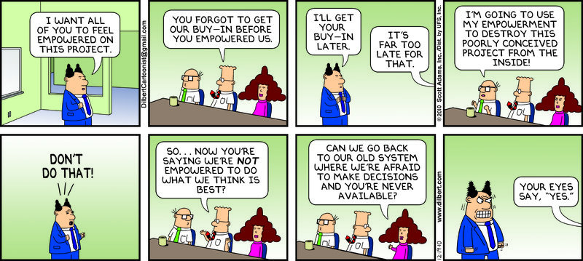
Team Management – Dilbert way ☺ (3/3)

Slide 49
Thank You

